Slide 1
What is a
Support Vector Machine?
An optimally defined surface
Typically nonlinear in the input space
Linear in a higher dimensional space
Implicitly defined by a kernel function
Acknowledgments: These slides combine and modify ones provided by Andrew Moore (CMU), Glenn Fung (Wisconsin), and Olvi Mangasarian (Wisconsin)

Slide 2
What are Support Vector Machines Used For?
Classification
Regression and data-fitting
Supervised and unsupervised learning

Slide 3
Linear Classifiers
x
f
y
f(x,w,b) = sign(w · x + b)
denotes +1
denotes -1
How would you classify this data?

Slide 4
Linear Classifiers
x
f
y
f(x,w,b) = sign(w · x + b)
denotes +1
denotes -1
How would you classify this data?

Slide 5
Linear Classifiers
x
f
y
f(x,w,b) = sign(w · x + b)
denotes +1
denotes -1
How would you classify this data?

Slide 6
Linear Classifiers
x
f
y
f(x,w,b) = sign(w · x + b)
denotes +1
denotes -1
How would you classify this data?

Slide 7
Linear Classifiers
x
f
y
f(x,w,b) = sign(w · x + b)
denotes +1
denotes -1
Any of these would be fine …
… but which is best?

Slide 8
Classifier Margin
x
f
y
f(x,w,b) = sign(w · x + b)
denotes +1
denotes -1
Define the margin of a linear classifier as the width that the boundary could be increased by before hitting a data point

Slide 9
Maximum Margin
x
f
y
f(x,w,b) = sign(w · x + b)
denotes +1
denotes -1
The maximum margin linear classifier is the linear classifier with the, um, maximum margin.
This is the simplest kind of SVM (Called an LSVM)
Linear SVM

Slide 10
Maximum Margin
x
f
y
f(x,w,b) = sign(w · x + b)
denotes +1
denotes -1
The maximum margin linear classifier is the linear classifier with the, um, maximum margin.
This is the simplest kind of SVM (Called an LSVM)
Support Vectors are those data points that the margin pushes up against
Linear SVM

Slide 11
Why Maximum Margin?
Intuitively this feels safest
If we’ve made a small error in the location of the boundary (it’s been jolted in its perpendicular direction) this gives us least chance of causing a misclassification
Robust to outliers since the model is immune to change/removal of any non-support-vector data points
There’s some theory (using VC dimension) that is related to (but not the same as) the proposition that this is a good thing
Empirically it works very well
f(x,w,b) = sign(w. x - b)
denotes +1
denotes -1
The maximum margin linear classifier is the linear classifier with the, um, maximum margin.
This is the simplest kind of SVM (Called an LSVM)
Support Vectors are those data points that the margin pushes up against

Slide 12
Specifying a Line and Margin
Plus-Plane
“Predict Class = +1” zone
Classifier Boundary
Minus-Plane
“Predict Class = -1” zone
How do we represent this mathematically?
… in m input dimensions?

Slide 13
Specifying a Line and Margin
Plus-Plane
“Predict Class = +1” zone
Classifier Boundary
Minus-Plane
“Predict Class = -1” zone
wx+b=1
wx+b=0
wx+b=-1
Plus-plane = { w · x + b = +1 }
Minus-plane = { w · x + b = -1 }
Classify as.. | +1 | if | w · x + b ≥ 1
 | -1 | if | w · x + b ≤ -1
 | Universe explodes | if | -1 < w · x + b < 1

Slide 14
Computing the Margin
M = Margin (width)
“Predict Class = +1” zone
How do we compute M in terms of w and b?
w
“Predict Class = -1” zone
wx+b=1
wx+b=0
wx+b=-1
Plus-plane = { w x + b = +1 }
Minus-plane = { w x + b = -1 }
Claim: The vector w is perpendicular to the Plus-Plane

Slide 15
Computing the Margin
M = Margin
“Predict Class = +1” zone
How do we compute M in terms of w and b?
w
“Predict Class = -1” zone
wx+b=1
wx+b=0
wx+b=-1
Plus-plane = { w x + b = +1 }
Minus-plane = { w x + b = -1 }
Claim: The vector w is perpendicular to the Plus Plane. Why?
Let u and v be two vectors on the Plus Plane. What is w . ( u – v ) ?
And so of course the vector w is also perpendicular to the Minus Plane

Slide 16
Computing the Margin
x⁺
M = Margin
“Predict Class = +1” zone
How do we compute M in terms of w and b?
w
x⁻
“Predict Class = -1” zone
wx+b=1
wx+b=0
wx+b=-1
Plus-plane = { w x + b = +1 }
Minus-plane = { w x + b = -1 }
The vector w is perpendicular to the Plus Plane
Let x⁻ be any point on the minus plane
Let x⁺ be the closest plus-plane-point to x⁻
Any location in ^{m}: not necessarily a datapoint
Any location in R^{m}: not necessarily a data point

Slide 17
Computing the Margin
x⁺
M = Margin
“Predict Class = +1” zone
How do we compute M in terms of w and b?
w
x⁻
“Predict Class = -1” zone
wx+b=1
wx+b=0
wx+b=-1
Plus-plane = { w x + b = +1 }
Minus-plane = { w x + b = -1 }
The vector w is perpendicular to the Plus Plane
Let x⁻ be any point on the minus plane
Let x⁺ be the closest plus-plane-point to x⁻
Claim: x⁺ = x⁻ + λ w for some value of λ. Why?

Slide 18
Computing the Margin
x⁺
M = Margin
“Predict Class = +1” zone
The line from x⁻ to x⁺ is perpendicular to the planes
So to get from x⁻ to x⁺ travel some distance in direction w
How do we compute M in terms of w and b?
w
x⁻
“Predict Class = -1” zone
wx+b=1
wx+b=0
wx+b=-1
Plus-plane = { w x + b = +1 }
Minus-plane = { w x + b = -1 }
The vector w is perpendicular to the Plus Plane
Let x⁻ be any point on the minus plane
Let x⁺ be the closest plus-plane-point to x⁻
Claim: x⁺ = x⁻ + λ w for some value of λ. Why?

Slide 19
Computing the Margin
x⁺
M = Margin
“Predict Class = +1” zone
w
x⁻
“Predict Class = -1” zone
wx+b=1
wx+b=0
wx+b=-1
What we know:
w x⁺ + b = +1
w x⁻ + b = -1
x⁺ = x⁻ + λ w
|x⁺ - x⁻ | = M
It’s now easy to get M in terms of w and b

Slide 20
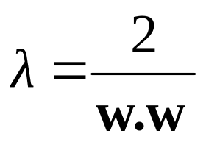
Computing the Margin
x⁺
M = Margin
“Predict Class = +1” zone
w
x⁻
“Predict Class = -1” zone
wx+b=1
wx+b=0
w (x ⁻ + λ w) + b = 1
⇒
w x ⁻ + b + λ ww = 1
⇒
-1 + λ ww = 1
⇒
wx+b=-1
What we know:
w x⁺ + b = +1
w x⁻ + b = -1
x⁺ = x⁻ + λ w
|x⁺ - x⁻ | = M
It’s now easy to get M in terms of w and b

Slide 21
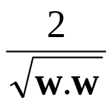
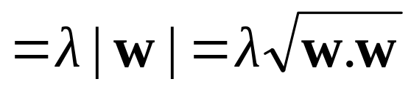
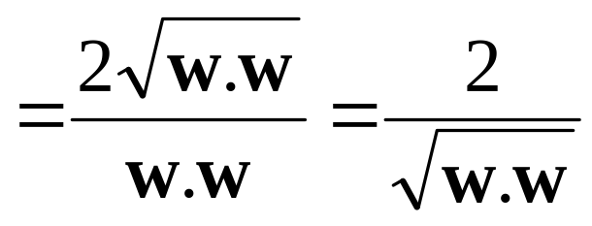
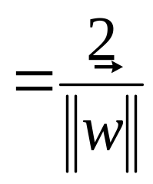
Computing the Margin
What we know:
w x⁺ + b = +1
w x⁻ + b = -1
x⁺ = x⁻ + λ w
|x⁺ - x⁻ | = M
x⁺
M = Margin =
“Predict Class = +1” zone
w
x⁻
“Predict Class = -1” zone
wx+b=1
wx+b=0
M = |x⁺ - x⁻ | =| λ w |=
wx+b=-1

Slide 22
Learning the Maximum Margin Classifier
x⁺
M = Margin =
“Predict Class = +1” zone
w
x⁻
“Predict Class = -1” zone
wx+b=1
wx+b=0
wx+b=-1
Given a guess of w and b we can
Compute whether all data points in the correct half-planes
Compute the width of the margin
So now we just need to write a program to search the space of w’s and b’s to find the widest margin that matches all the data points. How?

Slide 23
Learning via Quadratic Programming
QP is a well-studied class of optimization algorithms to maximize a quadratic function of some real-valued variables subject to linear constraints

Slide 24
Learning the Maximum Margin Classifier
M =
Given guess of w, b, we can
Compute whether all data points are in the correct half-planes
Compute the margin width
Assume R datapoints, each (x_{k} , y_{k}) where y_{k} = +/- 1
“Predict Class = +1” zone
“Predict Class = -1” zone
wx+b=1
wx+b=0
wx+b=-1
What should our quadratic optimization criterion be?
How many constraints will we have?
What should they be?

Slide 25
Learning the Maximum Margin Classifier
M =
Given guess of w , b we can
Compute whether all data points are in the correct half-planes
Compute the margin width
Assume R data points, each (x_{k} , y_{k}) where y_{k} = +/- 1
“Predict Class = +1” zone
“Predict Class = -1” zone
wx+b=1
wx+b=0
wx+b=-1
What should our quadratic optimization criterion be?
Minimize ||w||²
How many constraints will we have? R
What should they be?
w x_{k} + b ≥ 1 if y_{k} = 1
w x_{k} + b ≤ -1 if y_{k} = -1

Slide 26
Uh-oh!
This is going to be a problem!
What should we do?
denotes +1
denotes -1

Slide 27
Uh-oh!
This is going to be a problem!
What should we do?
Idea 1:
  Find minimum ||w||², while minimizing number of training set errors
    Problem: Two things to minimize makes for an ill-defined optimization
denotes +1
denotes -1

Slide 28
Uh-oh!
This is going to be a problem!
What should we do?
Idea 1.1:
  Minimize
  ||w||² + C (#train errors)
There’s a serious practical problem that’s about to make us reject this approach. Can you guess what it is?
denotes +1
denotes -1
Tradeoff parameter

Slide 29
Uh-oh!
This is going to be a problem!
What should we do?
Idea 1.1:
  Minimize
  ||w||² + C (#train errors)
There’s a serious practical problem that’s about to make us reject this approach. Can you guess what it is?
denotes +1
denotes -1
Tradeoff parameter
Can’t be expressed as a Quadratic Programming problem.
Solving it may be too slow.
(Also, doesn’t distinguish between disastrous errors and near misses)
So… any other ideas?

Slide 30
Uh-oh!
This is going to be a problem!
What should we do?
Idea 2.0:
  Minimize
  ||w||² + C (distance of error points to their correct place)
denotes +1
denotes -1

Slide 31
Learning Maximum Margin with Noise
M =
Given guess of w, b, we can
Compute sum of distances of points to their correct zones
Compute the margin width
Assume R datapoints, each (x_{k} , y_{k}) where y_{k} = +/- 1
wx+b=1
wx+b=0
wx+b=-1
What should our quadratic optimization criterion be?
How many constraints will we have?
What should they be?

Slide 32
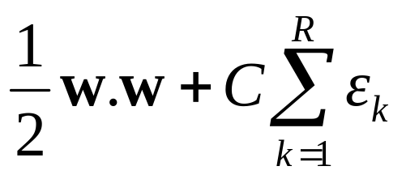
Learning Maximum Margin with Noise
ε₁₁
M =
Given guess of w , b we can
Compute sum of distances of points to their correct zones
Compute the margin width
Assume R datapoints, each (x_{k} , y_{k}) where y_{k} = +/- 1
ε₂
wx+b=1
ε₇
wx+b=0
wx+b=-1
What should our quadratic optimization criterion be?
Minimize
How many constraints will we have? R
What should they be?
w . x_{k} + b >= 1-ε_{k} if y_{k} = 1
w . x_{k} + b <= -1+ε_{k} if y_{k} = -1

Slide 33
Learning Maximum Margin with Noise
m = # input dimensions
M =
Given guess of w , b we can
Compute sum of distances of points to their correct zones
Compute the margin width
Assume R datapoints, each (x_{k},y_{k}) where y_{k} = +/- 1
ε₁₁
ε₂
Our original (noiseless data) QP had m+1 variables: w₁, w₂, … w_{m}, and b.
Our new (noisy data) QP has m+1+R variables: w₁, w₂, … w_{m}, b, ε_{k} , ε₁ ,… ε_{R}
wx+b=1
ε₇
wx+b=0
wx+b=-1
What should our quadratic optimization criterion be?
Minimize
How many constraints will we have? R
What should they be?
w . x_{k} + b >= 1-ε_{k} if y_{k} = 1
w . x_{k} + b <= -1+ε_{k} if y_{k} = -1
R= # records

Slide 34
Learning Maximum Margin with Noise
M =
Given guess of w , b we can
Compute sum of distances of points to their correct zones
Compute the margin width
Assume R datapoints, each (x_{k},y_{k}) where y_{k} = +/- 1
ε₁₁
ε₂
wx+b=1
ε₇
wx+b=0
wx+b=-1
What should our quadratic optimization criterion be?
Minimize
How many constraints will we have? R
What should they be?
w . x_{k} + b >= 1-ε_{k} if y_{k} = 1
w . x_{k} + b <= -1+ε_{k} if y_{k} = -1
There’s a bug in this QP. Can you spot it?

Slide 35
Learning Maximum Margin with Noise
M =
Given guess of w , b we can
Compute sum of distances of points to their correct zones
Compute the margin width
Assume R datapoints, each (x_{k},y_{k}) where y_{k} = +/- 1
ε₁₁
ε₂
wx+b=1
ε₇
wx+b=0
wx+b=-1
What should our quadratic optimization criterion be?
Minimize
How many constraints will we have? 2R
What should they be?
w . x_{k} + b >= 1-ε_{k} if y_{k} = 1
w . x_{k} + b <= -1+ε_{k} if y_{k} = -1
ε_{k} >= 0 for all k

Slide 36
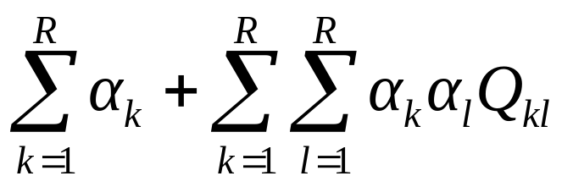
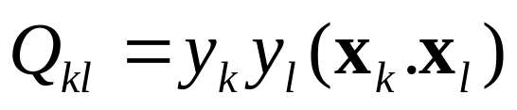
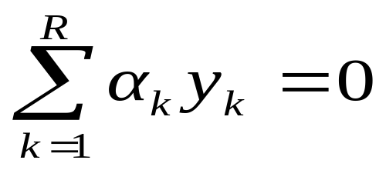
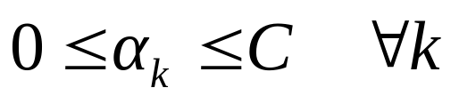
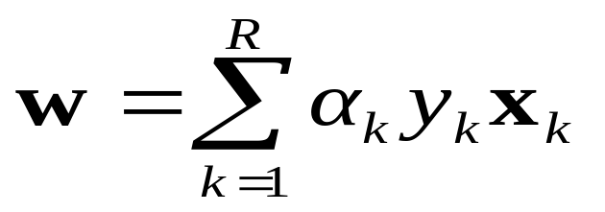
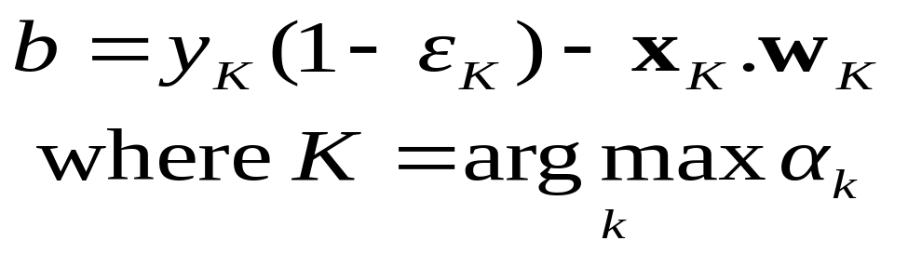
An Equivalent QP
Maximize
where
Subject to these constraints:
Then define:
Then classify with:
f(x,w,b) = sign(w. x - b)

Slide 37
An Equivalent QP
Maximize
where
Subject to these constraints:
Then define:
Datapoints with α_{k} > 0 will be the support vectors
Then classify with:
f(x,w,b) = sign(w. x - b)
..so this sum only needs to be over the support vectors.

Slide 38
An Equivalent QP
Why did I tell you about this equivalent QP?
It’s a formulation that QP packages can optimize more quickly
Because of further jaw-dropping developments you’re about to learn.
Maximize
where
Subject to these constraints:
Then define:
Datapoints with α_{k} > 0 will be the support vectors
Then classify with:
f(x,w,b) = sign(w. x - b)
..so this sum only needs to be over the support vectors.

Slide 39
Suppose we’re in 1 Dimension
What would SVMs do with this data?
x=0

Slide 40
Suppose we’re in 1 Dimension
Not a big surprise
x=0
Positive “plane”
Negative “plane”

Slide 41
Harder 1-Dimensional Dataset
That’s wiped the smirk off SVM’s face
What can be done about this?
x=0

Slide 42
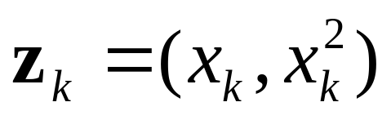
Harder 1-Dimensional Dataset
The Kernel Trick: Preprocess the data, mapping x into higher dimensional space F(x)
x=0

Slide 43
Harder 1-Dimensional Dataset
The Kernel Trick: Preprocess the data, mapping x into higher dimensional space F(x)
x=0

Slide 44
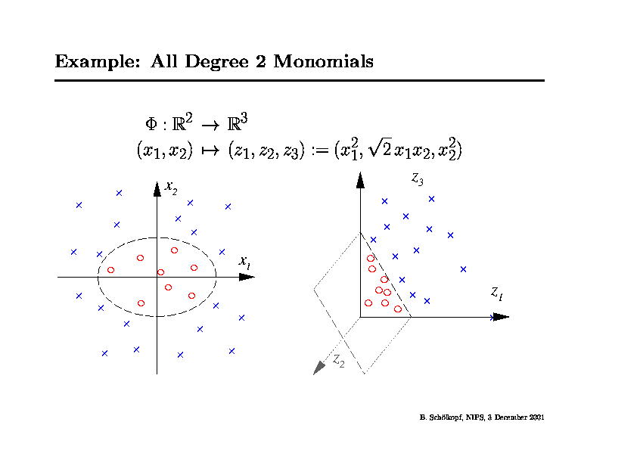

Slide 45
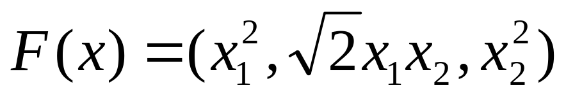
Project examples into some higher dimensional space where the data is linearly separable, defined by z = F(x)
Training depends only on dot products of the form
    F(x_{i}) · F(x_{j})
Example:
    K(x_{i}, x_{j}) = F(x_{i}) · F(x_{j}) = (x_{i} · x_{j})²

Slide 46
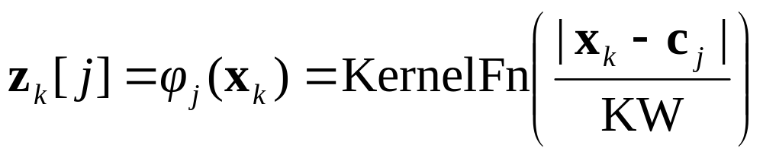
Common SVM Basis Functions
z_{k} = ( polynomial terms of x_{k} of degree 1 to q )
z_{k} = ( radial basis functions of x_{k} )
z_{k} = ( sigmoid functions of x_{k} )

Slide 47
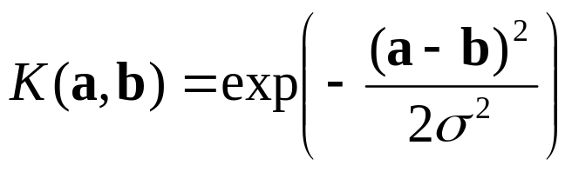

SVM Kernel Functions
K(a,b)=(a . b +1)^{d} is an example of an SVM kernel function
Beyond polynomials there are other very high dimensional basis functions that can be made practical by finding the right kernel function
  Radial-Basis-style Kernel Function:
  Neural-Net-style Kernel Function:
σ, κ and δ are magic parameters that must be chosen by a model selection method such as CV or VCSRM

Slide 48
The Federalist Papers
Written in 1787-1788 by Alexander Hamilton, John Jay, and James Madison to persuade the citizens of New York to ratify the constitution
Papers consisted of short essays, 900 to 3500 words in length
Authorship of 12 of those papers have been in dispute ( Madison or Hamilton); these papers are referred to as the disputed Federalist papers

Slide 49
Description of the Data
For every paper:
  Machine readable text was created using a scanner
  Computed relative frequencies of 70 words that Mosteller-Wallace identified as good candidates for author-attribution studies
  Each document is represented as a vector containing the 70 real numbers corresponding to the 70 word frequencies
The dataset consists of 118 papers:
  50 Madison papers
  56 Hamilton papers
  12 disputed papers

Slide 50
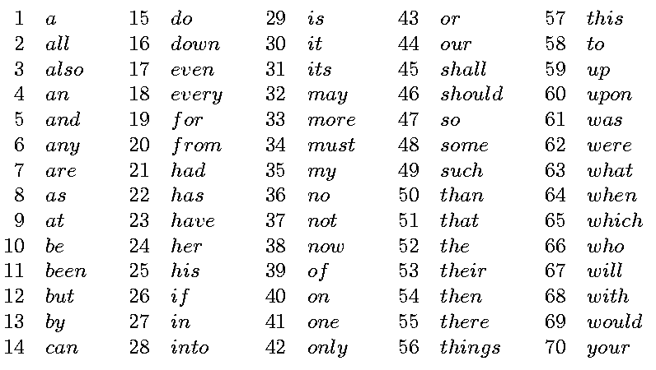
Function Words Based on Relative Frequencies

Slide 51
SLA Feature Selection for Classifying the Disputed Federalist Papers
Apply the SVM Successive Linearization Algorithm for feature selection to:
  Train on the 106 Federalist papers with known authors
  Find a classification hyperplane that uses as few words as possible
Use the hyperplane to classify the 12 disputed papers

Slide 52
Hyperplane Classifier Using 3 Words
A hyperplane depending on three words was found:
0.537to + 24.663upon + 2.953would = 66.616
All disputed papers ended up on the Madison side of the plane

Slide 53
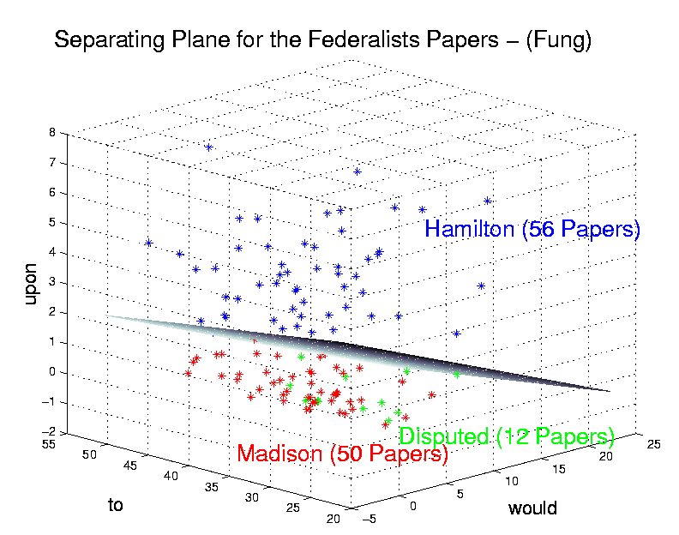
Results: 3D Plot of Hyperplane

Slide 54
Multi-Class Classification
SVMs can only handle two-class outputs
What can be done?
Answer: for N-class problems, learn N SVM’s:
  SVM 1 learns “Output=1” vs “Output ≠ 1”
  SVM 2 learns “Output=2” vs “Output ≠ 2”
  :
  SVM N learns “Output=N” vs “Output ≠ N”
To predict the output for a new input, just predict with each SVM and find out which one puts the prediction the furthest into the positive region

Slide 55
Summary
Learning linear functions
  Pick separating plane that maximizes margin
  Separating plane defined in terms of support vectors only
Learning non-linear functions
  Project examples into higher dimensional space
  Use kernel functions for efficiency
Generally avoids over-fitting problem
Global optimization method; no local optima
Can be expensive to apply, especially for multi-class problems

Slide 56
SVM implementations I.
SVM^{light} - satyr.net2.private:/usr/local/bin
        svm_learn, svm_classify
bsvm - satyr.net2.private:/usr/local/bin
        svm-train, svm-classify, svm-scale
libsvm - satyr.net2.private:/usr/local/bin
        svm-train, svm-predict, svm-scale, svm-toy
mySVM
MATLAB svm toolbox
Differences: available Kernel functions, optimization, multiple class., user interfaces

Slide 57
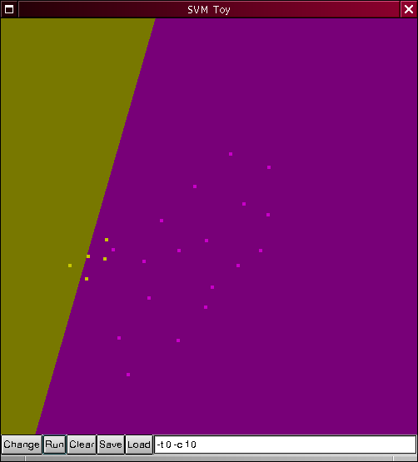
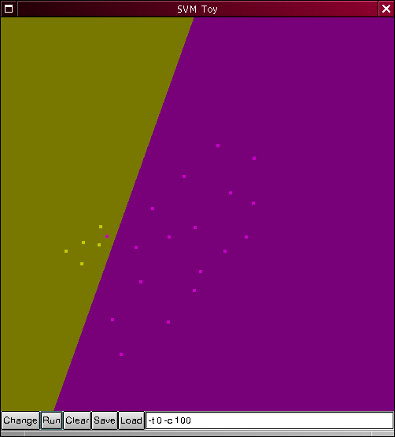
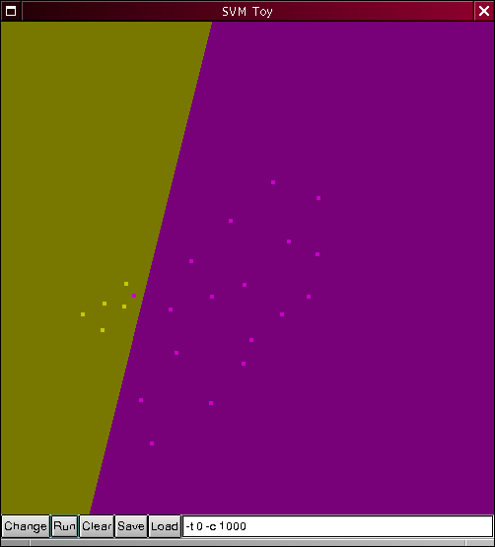
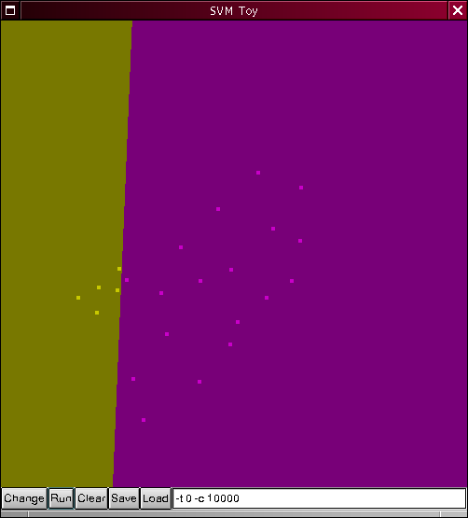


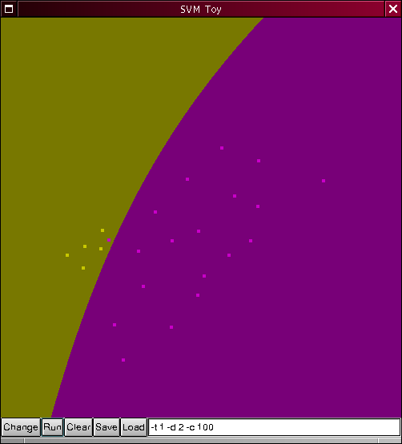
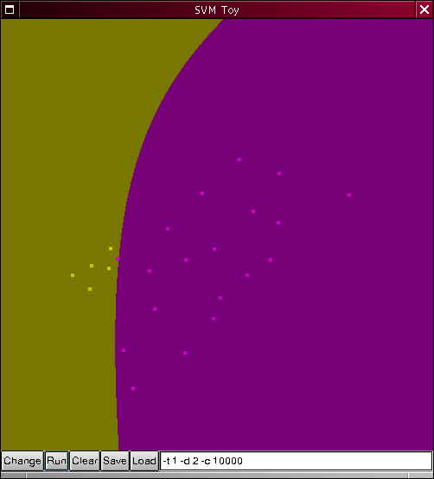
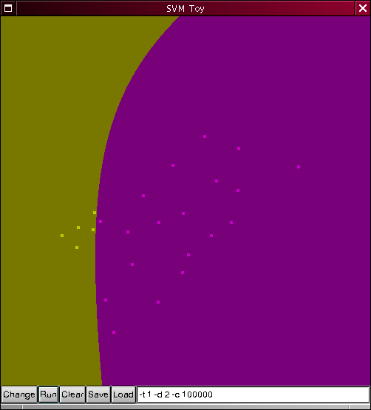
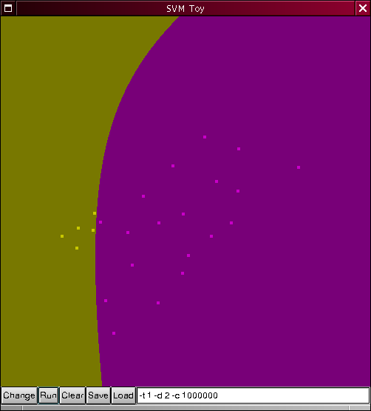
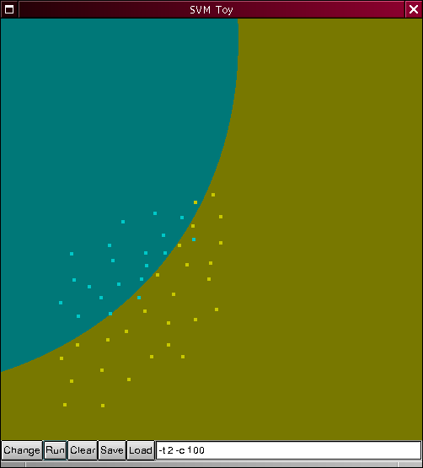
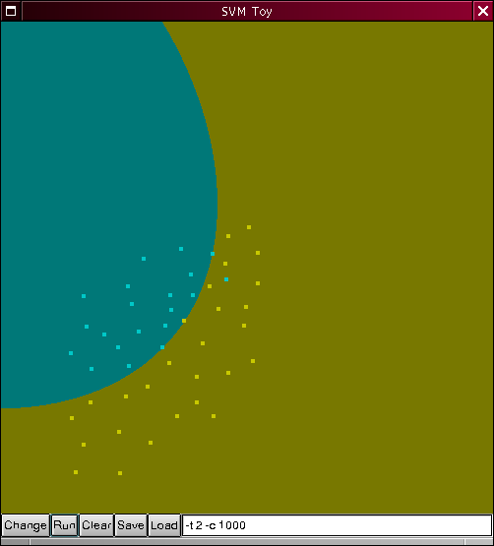
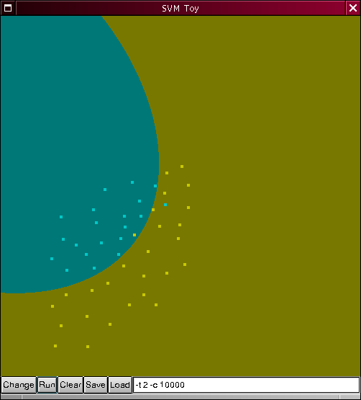
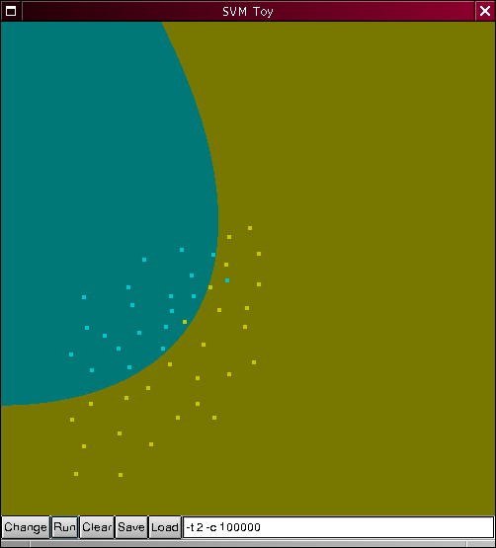
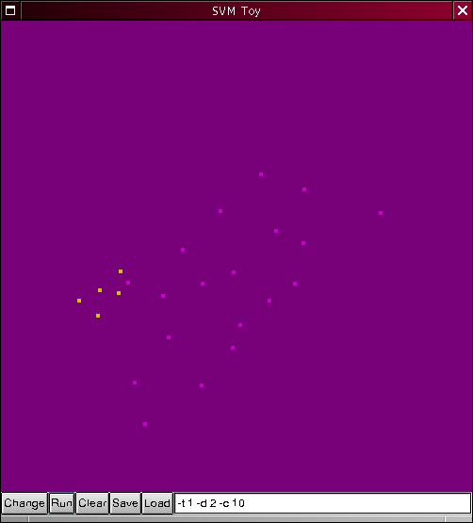
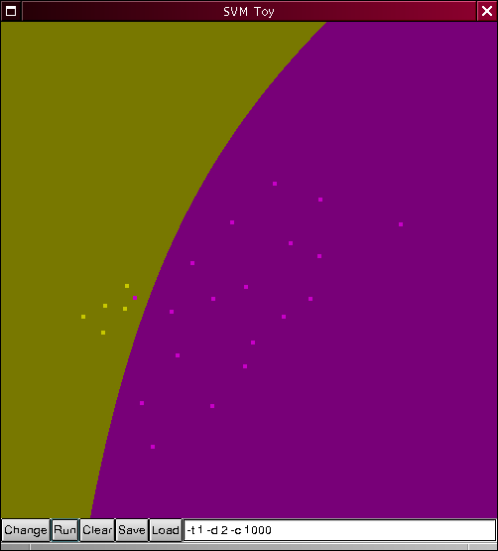
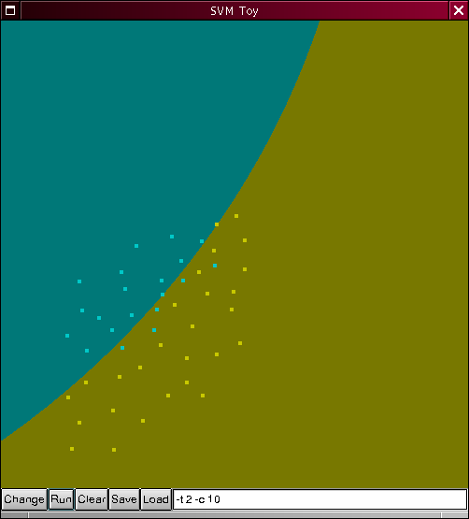
SVM implementations II.
SVM^{light}
  Simple text data format
  Fast, C routines
bsvm
  Multiple class.
LIBSVM
  GUI: svm-toy
MATLAB svm toolbox
  Graphical interface 2D

Slide 58
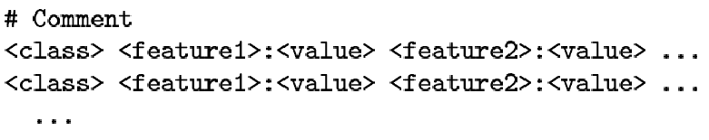
Data format
Universal, simple, human readable text
SVM^{light}
libsvm
  2D gr. interface
bsvm
  multi-class.

Slide 59
References
Steve R. Gunn: SVM for Classification and Regression (1998)
Ch. J. C. Burges: A Tutorial on SVM for Pattern Recognition (1998)
T. Evgeniou, M. Pontil, T. Poggio: Regularization Networks and SVM (2000)
SVM for predicting protein structural class, BMC Bioinformatics, (2001), 2:3
Knowledge-based analysis of microarray gene expression data by using support vector machines, PNAS, 97, 262-267
SVM classification and validation of cancer tissue samples using microarray expression data, Bioinformatics, (2000), 10(16), 906-914
http://www.kernel-machines.org/publications.html

